Slide 1
LUMEMOTO
Stock and factory supply from our own warehouse in Yiwu, China
Company profile 2026
Anze Trading Co., Ltd., Yiwu, Zhejiang, China
lumemoto.com

Slide 2
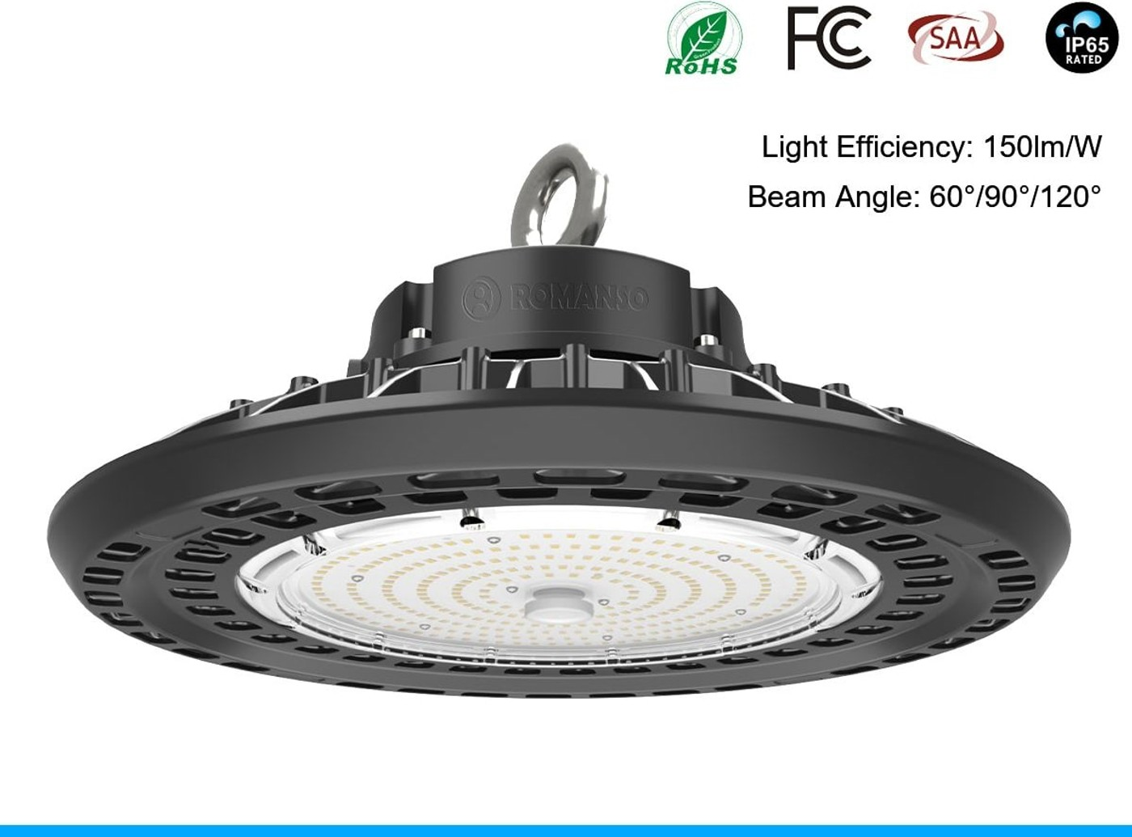
Who we are
We are a professional export company based in Yiwu, Zhejiang. We buy clearance stock outright and hold it in our own 50,000 m² warehouse, and we run made-to-order lines through the factories we are tied to.
Our partner factories are long-term relationships, not one-off introductions. We hold their qualification documents on file and get first call on capacity, which is why we can commit to a price and a delivery date.
Most of our buyers take several categories at once. That is the normal case here, not an exception.

Slide 3
What we do
01
Private label and branding
02
Specification matching
Your logo on the product, the colour box, the manual and the master carton.
Send a photo, a sample or a competitor link. We find the closest match.
03
Custom tooling
04
Category building
For a new item we manage the mould project at the factory, with T0 and T1 samples.
Tell us the market and the price points. We propose a range that works together.
05
Compliance coordination
06
Samples and prototyping
Test reports and declarations arranged per order and per destination.
Stock samples in 48 hours, customised samples in about a week.

Slide 4
What we source
Lighting
Industrial high bay, street and road, flood and high mast, panel and troffer, track and downlight
14 product lines
Power and solar
Solar panels, hybrid inverters, batteries, diesel and petrol generators, solar pumps, water treatment
13 product lines
Clothing and general merchandise
Apparel, textiles, kitchenware, cleaning and storage, bags and wallets, phone accessories
8 product lines

Slide 5
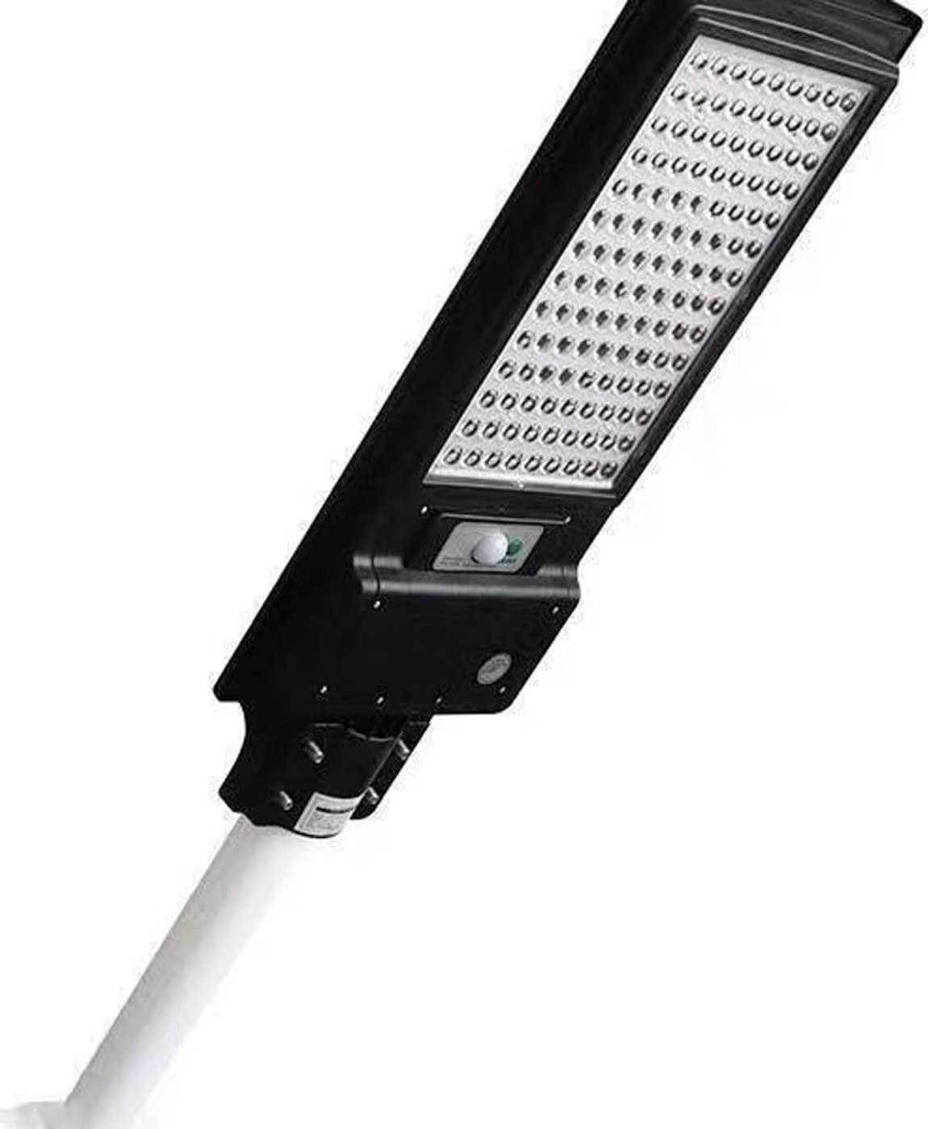
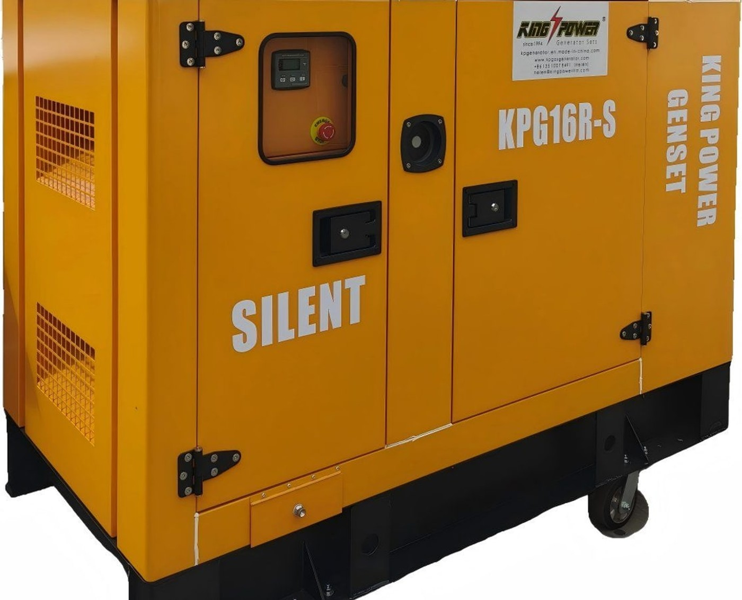
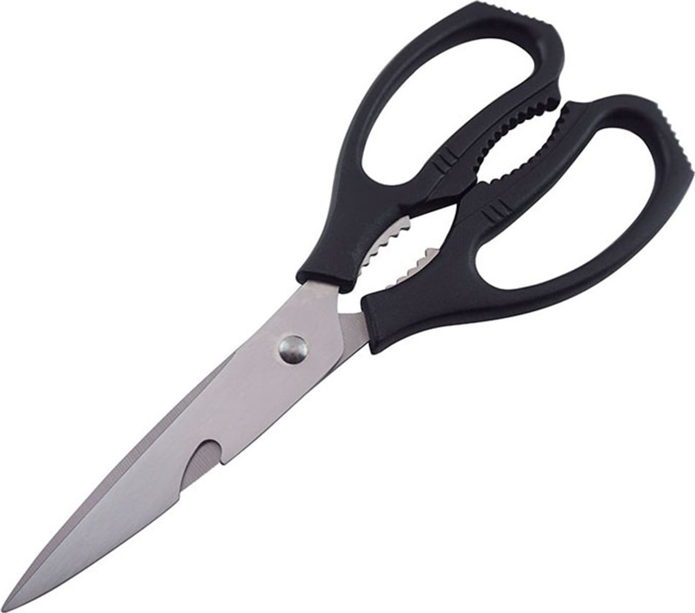
Products we ship
LED street light
Silent diesel generator
Stainless steel kitchen scissors
Every item shown here is stock we have handled. Send us a photo of what you sell and we will quote the closest match from the same range.

Slide 6
Markets we serve
West Africa
East Africa
Southern Africa
North Africa
Mexico
Latin America
Documentation is arranged for the destination, not left to you: SONCAP for Nigeria, NOM for Mexico, CE and RoHS for general export, FDA and LFGB for anything that touches food.

Slide 7
How an order runs
01
Enquiry and requirements
02
Sourcing and quotation
Send your market, the categories you want and your price points.
We walk the market and price each line against several suppliers.
03
Samples and approval
04
Order and inspection
You approve the sample, the artwork and the packing before we buy.
We place the orders, follow each supplier and inspect against a checklist.
05
Warehouse, consolidation and loading
06
Documents and after-sales
Stock is pulled from our own warehouse and made-to-order goods arrive from the partner factories. Everything goes into one shipment, with photos of the loaded container.
Invoice, packing list, certificate of origin and test reports.

Slide 8
Quality control
Stock lines are bought outright and held in our own 50,000 m² warehouse in Yiwu, so we check them before they are ever offered to you. Made-to-order lines are inspected at the partner factory against a checklist you help set. Faults found at that stage cost far less to fix than faults found in your warehouse.
Clearance stock checked in our own warehouse before it is listed
Long-term factory partners, with licences and export records on file
Pre-shipment inspection on quantity, colour and function
Packing and carton drop test before loading
Written inspection report with photos before you pay the balance
Claims followed up with the supplier, not handed back to you

Slide 9
Why buyers work with us
Our own 50,000 m² warehouse in Yiwu
Tied to our partner factories
Clearance stock we buy outright sits in our warehouse, filmed on request before you commit.
Long-term partners with first call on capacity, and their qualification documents on file.
Inspected before it ships
Documents for your market
You get photos and a written report before you pay the balance.
SONCAP, NOM, CE, RoHS, FDA and LFGB arranged per destination.
Your brand on the goods
One person, start to finish
Logo printing, custom colours, own packaging and gift boxes.
The same contact answers your questions and chases the suppliers.

Slide 10
Trade terms
Trade terms
EXW, FOB, CIF, DDP
Payment
T/T and L/C at sight
Loading ports
Ningbo, Yiwu, Shanghai
Lead time
Ready stock 7 to 15 days. Made to order 20 to 35 days.
Packing data
Carton quantity, gross weight and carton size on every product page
Mixed containers
Many suppliers consolidated into one shipment

Slide 11
Get a quotation
Send us the market, the items and the quantity. You will get photos, packing data and pricing within 24 hours.
Email
jiandan.0403@gmail.com
Phone and WhatsApp
+86 134 5038 1308
WeChat
13450381308
Address
Yiwu, Zhejiang, China
Website
lumemoto.com

